Slide 1
District Advisory Committee Update
John Berray
Math Curriculum Specialist
Go here for this presentation: bit.ly/DAC-GUHSDmath
January 8, 2019

Slide 2
Updates
1 Integrated Math I, II, and III recap
2 Big ideas of CPM
3 CPM parent resources
4 GUHSD math pathways

Slide 3
IM I, II, III

Slide 4
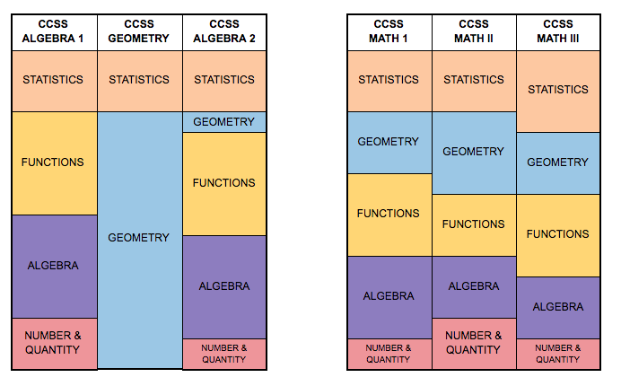
Traditional Pathway Integrated Pathway
Notes:
http://bit.ly/IMpathway

Slide 5
Integrated Math
The following three courses make up the Integrated Math Pathway:
Integrated Math I - (IM I)
Integrated Math II - (IM II)
Integrated Math III - (IM III)
There is no specific fourth year course in the Integrated Pathway. We are in the process of determining what options will be available for students beyond those historically available - Precalculus, AP Stats, AP Calculus, among others.

Slide 6
California Common Core State Standards in Math
(CA CCSS-M)
Adopted in 2010
Content Standards (different at each grade level)
Standards for Mathematical Practice (identical at each grade level)
The 8th grade standards in the CA CCSS-M are significantly more rigorous than the Algebra 1 course that many students took in 8th grade.
Notes:
Focus, Coherence, Rigor

Slide 7
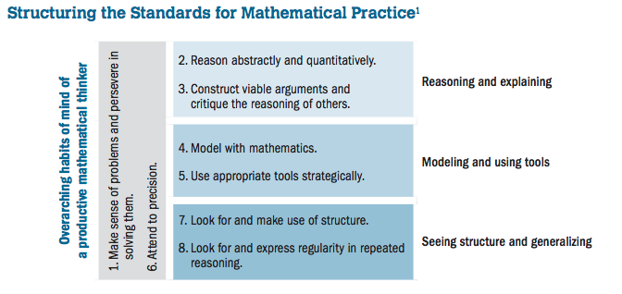
Standards for Mathematical Practices (SMPs)
Notes:
Focus, Coherence, Rigor

Slide 8
Newly Adopted Curriculum

Slide 9
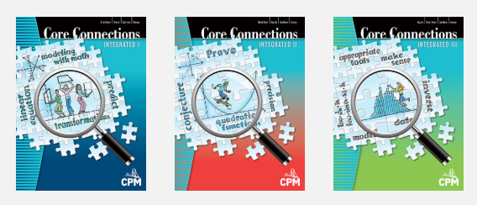
3 Pillars of CPM Curriculum
Collaboration
Problem-Based Learning
Mixed, Spaced Practice (mastery over time)
IM I
IM II
IM III
Notes:
Team roles (individual and group accountability - Resource Manager, Facilitator, Recorder/Reporter, Task Manager)
Discourse is important!

Slide 10
Notes:
Taken from section 2.1.1 of the CPM Integrated I book
Every student has an ebook

Slide 11
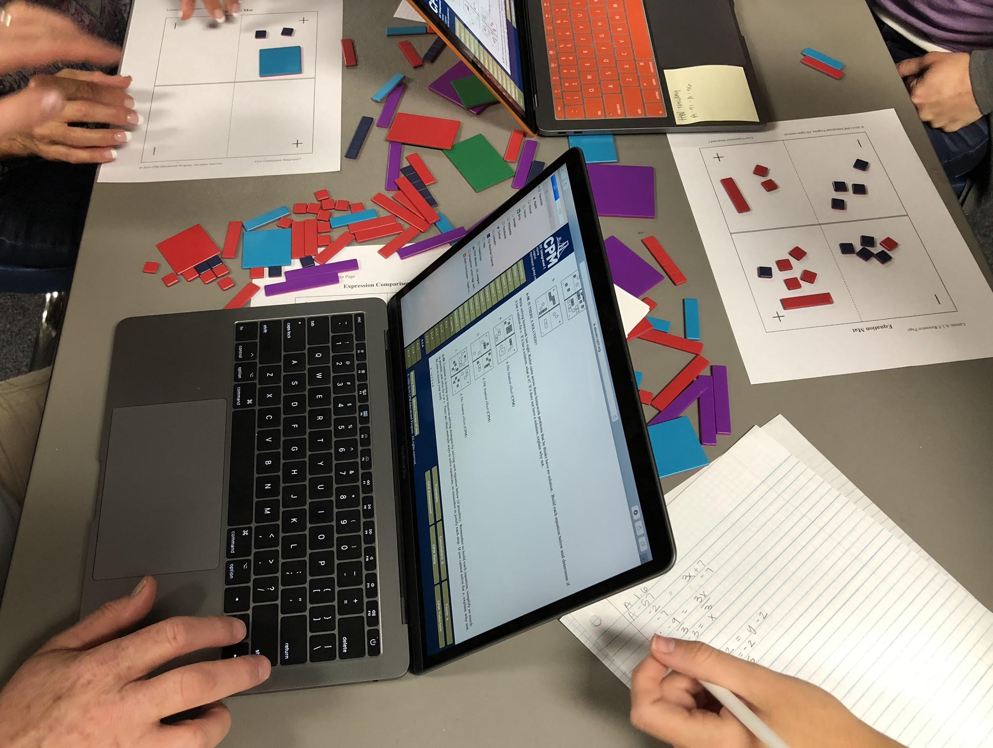

Slide 12
CPM Implementation
2018-2019: Integrated I
2019-2020: Integrated I, Integrated II
2020-2021: Integrated I, Integrated II, Integrated III
Teachers are attending 4 days of professional learning run by CPM over the summer and 4 days throughout the year to prepare for these new classes.
Notes:
Team roles (individual and group accountability - Resource Manager, Facilitator, Recorder/Reporter, Task Manager)

Slide 13
Math Pathways

Slide 14
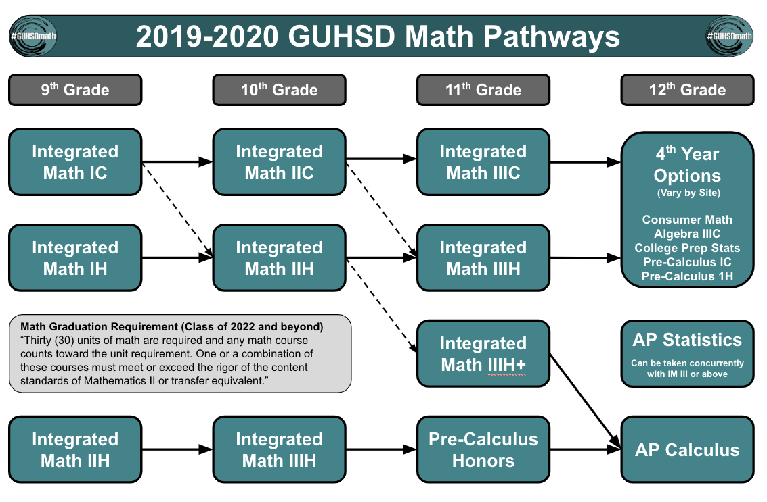

Slide 15
The “Legacy” Math Graduation Requirement
“Thirty (30) units of math are required and any math course counts toward the unit requirement. Ten (10) units must include a full algebra I course and ten (10) units must include an additional mathematics course that is not a prerequisite to algebra I.”
Notes:
Applies to students in the tradition pathway until the last class graduates.

Slide 16
Ways you Can Support Your Students
Ask students what they are LEARNING, not just doing. Let students know that this change will benefit them.
Be aware of the curriculum transition from 8th grade to the GUHSD:
http://bit.ly/eastcountymath
Parental support from CPM
Homework help from CPM
Parent Guide with Resource Pages from CPM

Slide 17
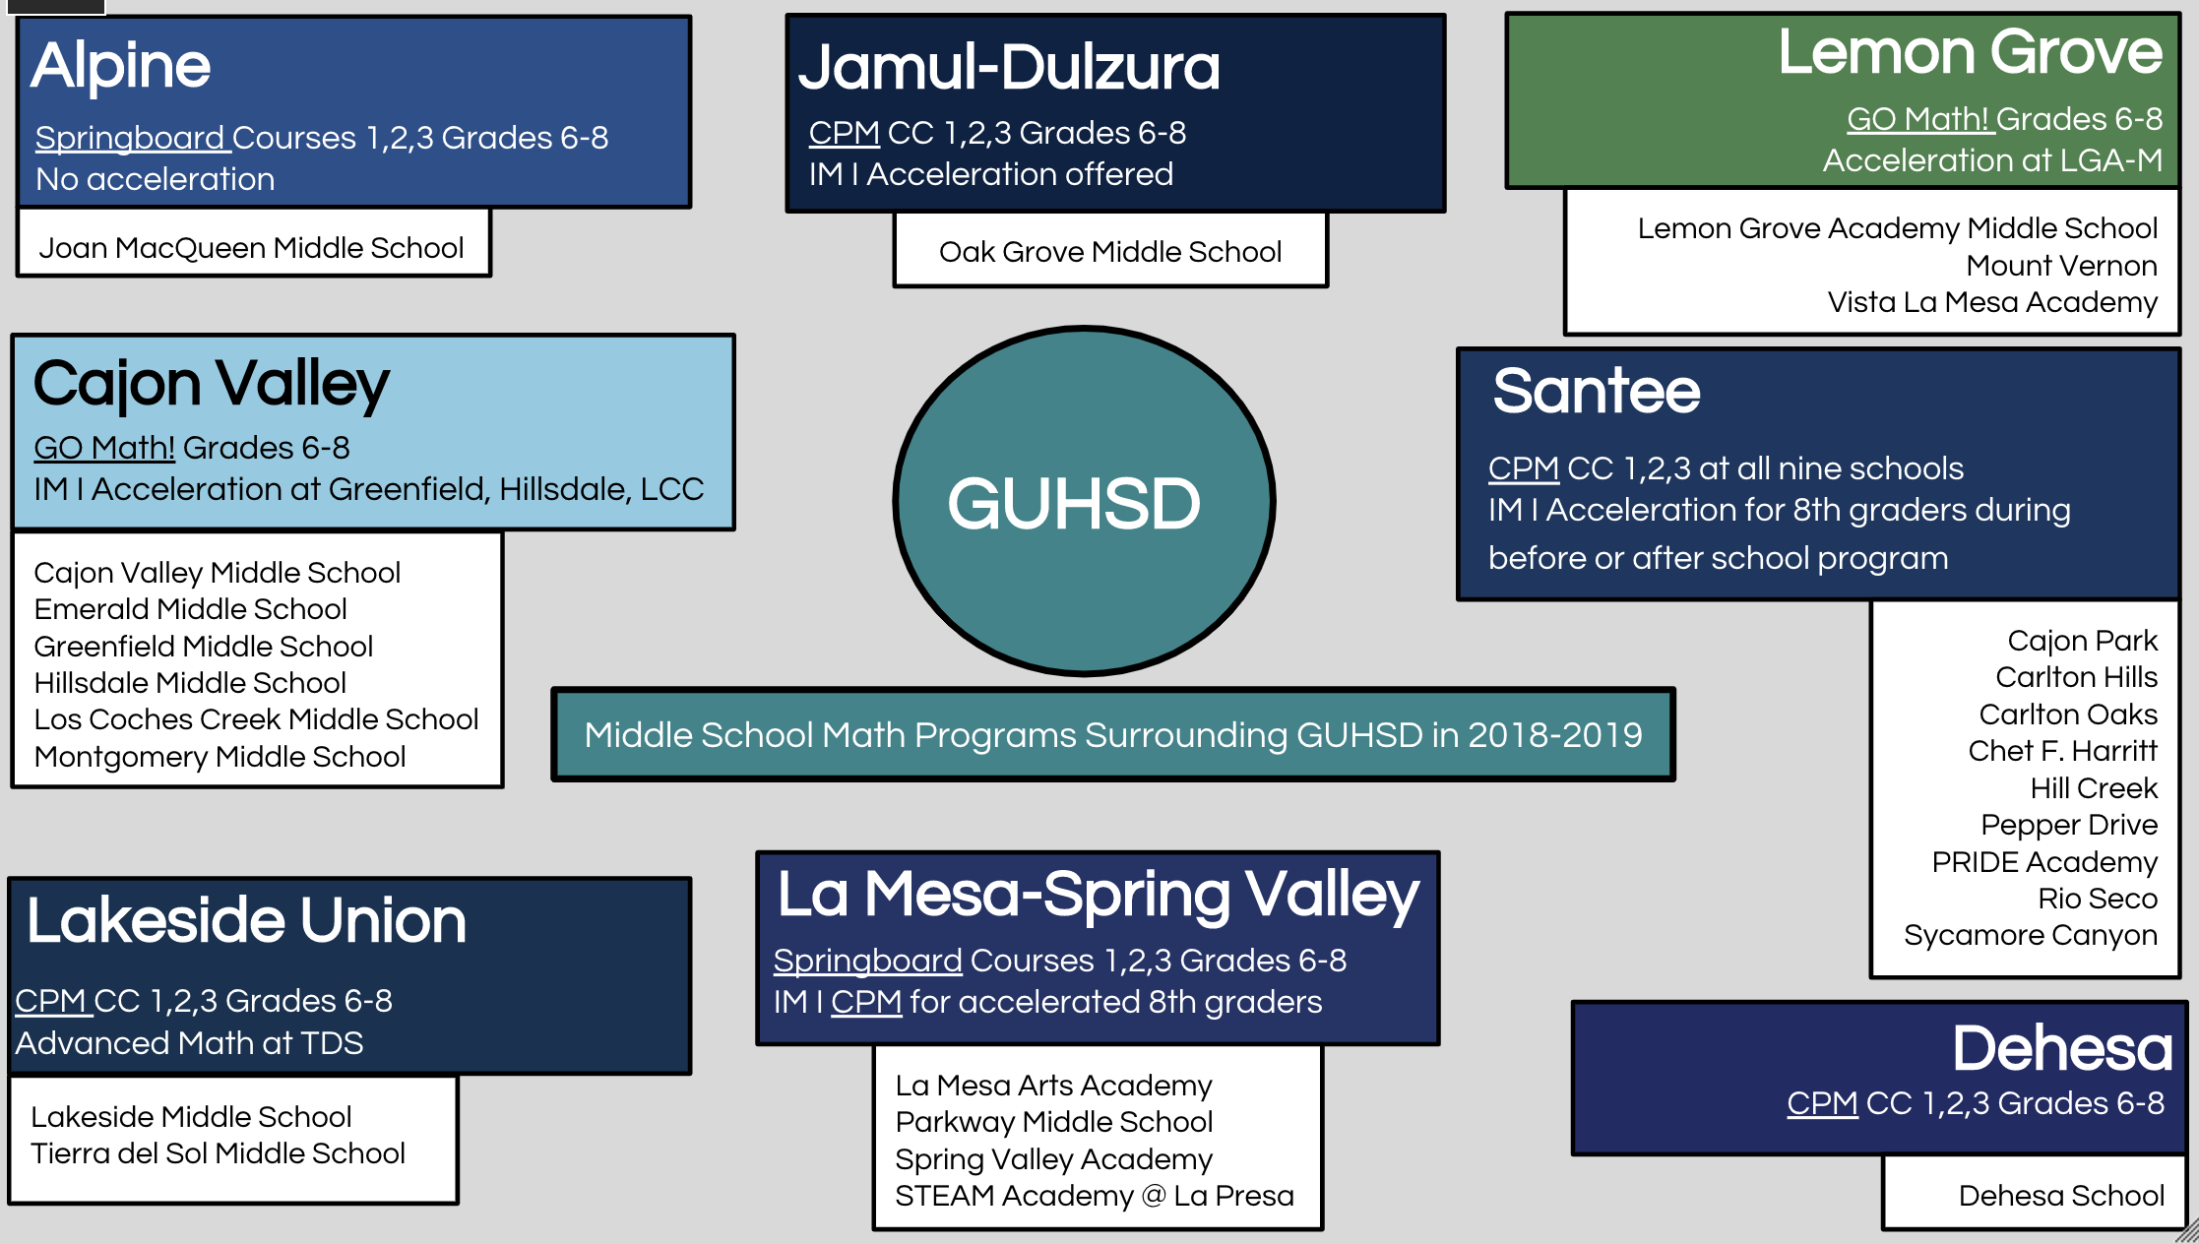
Notes:
http://bit.ly/eastcountymath

Slide 18
According to Catalyzing Change in High School Mathematics (NCTM),
High school mathematics empowers students to-
Expand professional opportunity;
Understand and critique the world; and
Experience wonder, joy, and beauty.
Notes:
https://www.nctm.org/Store/Products/Catalyzing-Change-in-High-School-Mathematics/

Slide 19
Resources
California Common Core State Standards - Math
GUHSDmath FAQ

Slide 20
Let’s Connect!
John Berray
jberray@guhsd.net
Math Curriculum Specialist
Feel free to share this presentation with others: bit.ly/DAC-GUHSDmath

